Slide 1
SQL INTRODUCTION
Dr.Aparna Chaparala

Slide 2
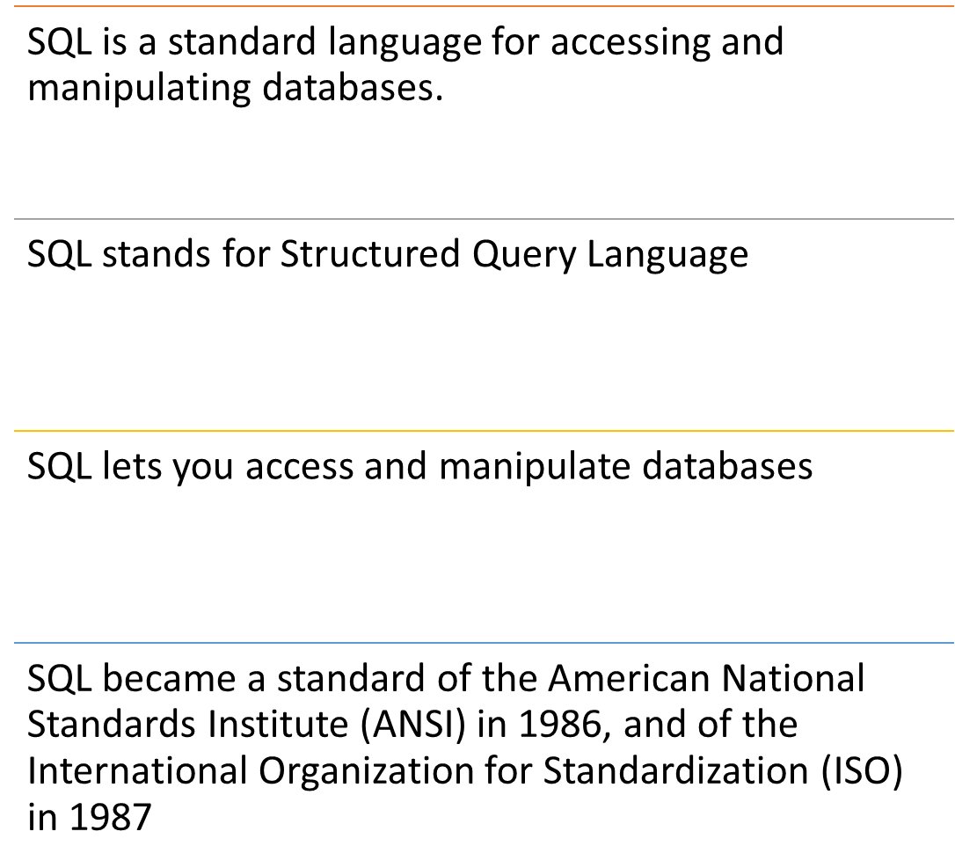
What is SQL?

Slide 3
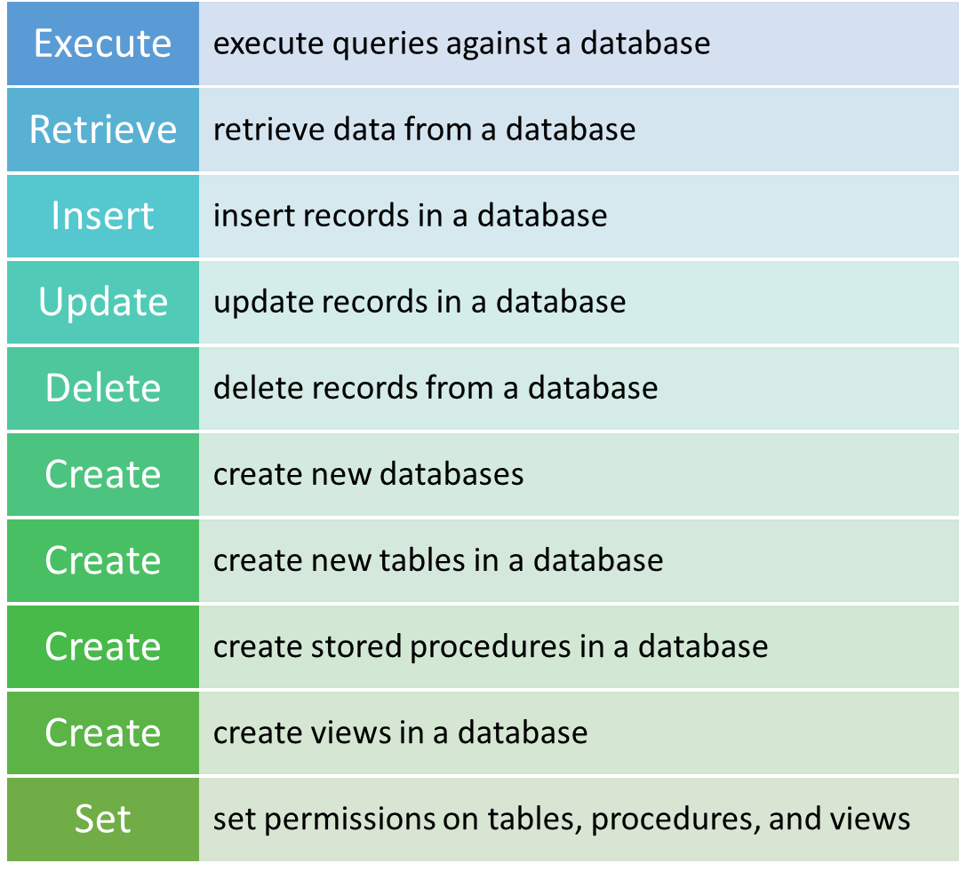
What can SQL do?

Slide 4
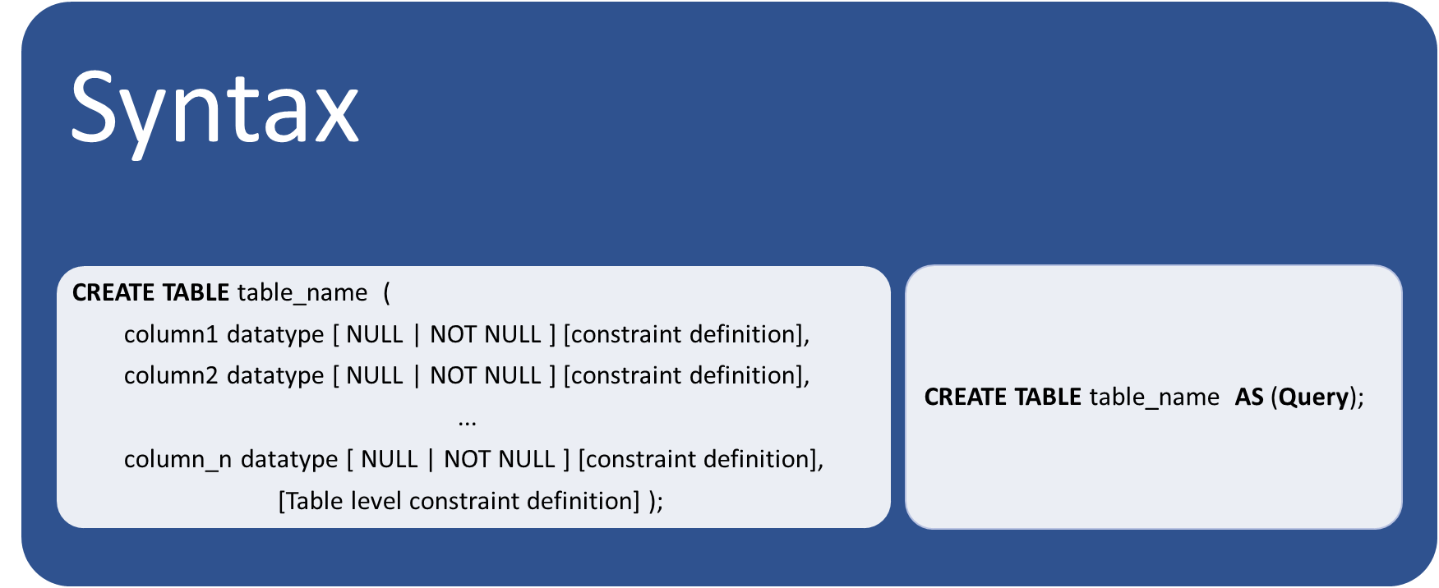
CREATE TABLE Statement

Slide 5
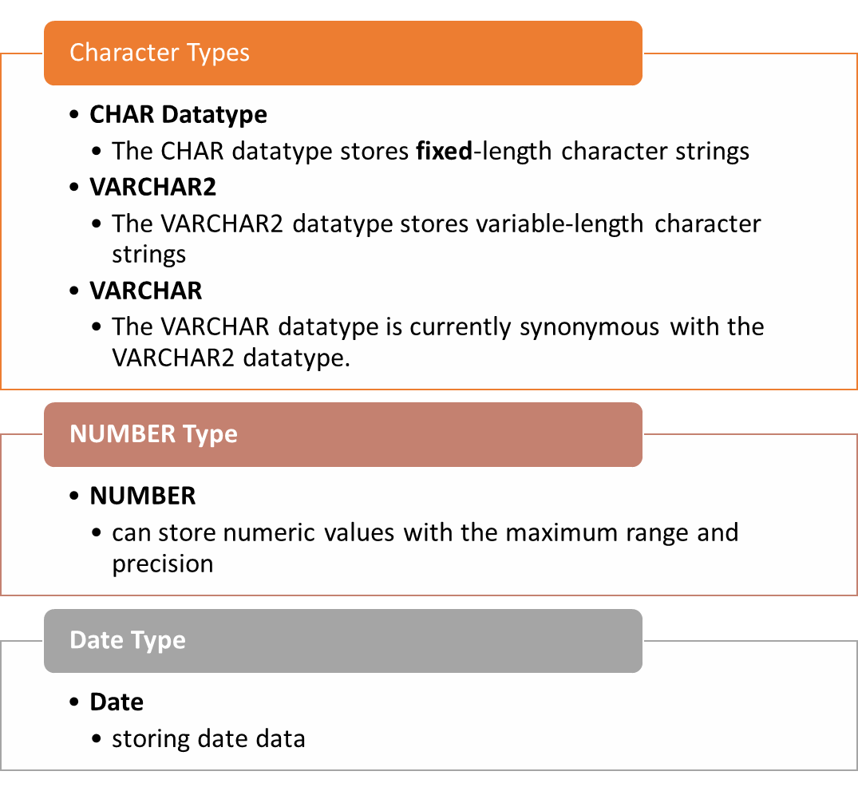
Oracle 8i Built-in Data Types

Slide 6
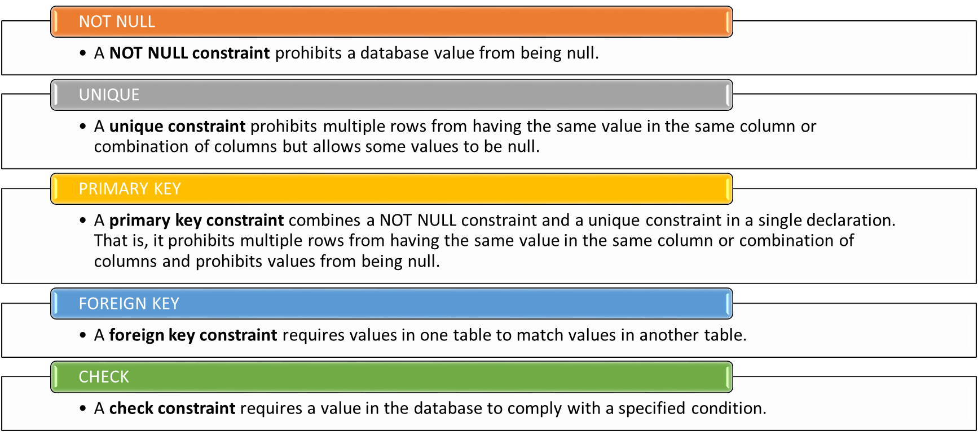
Constraints

Slide 7
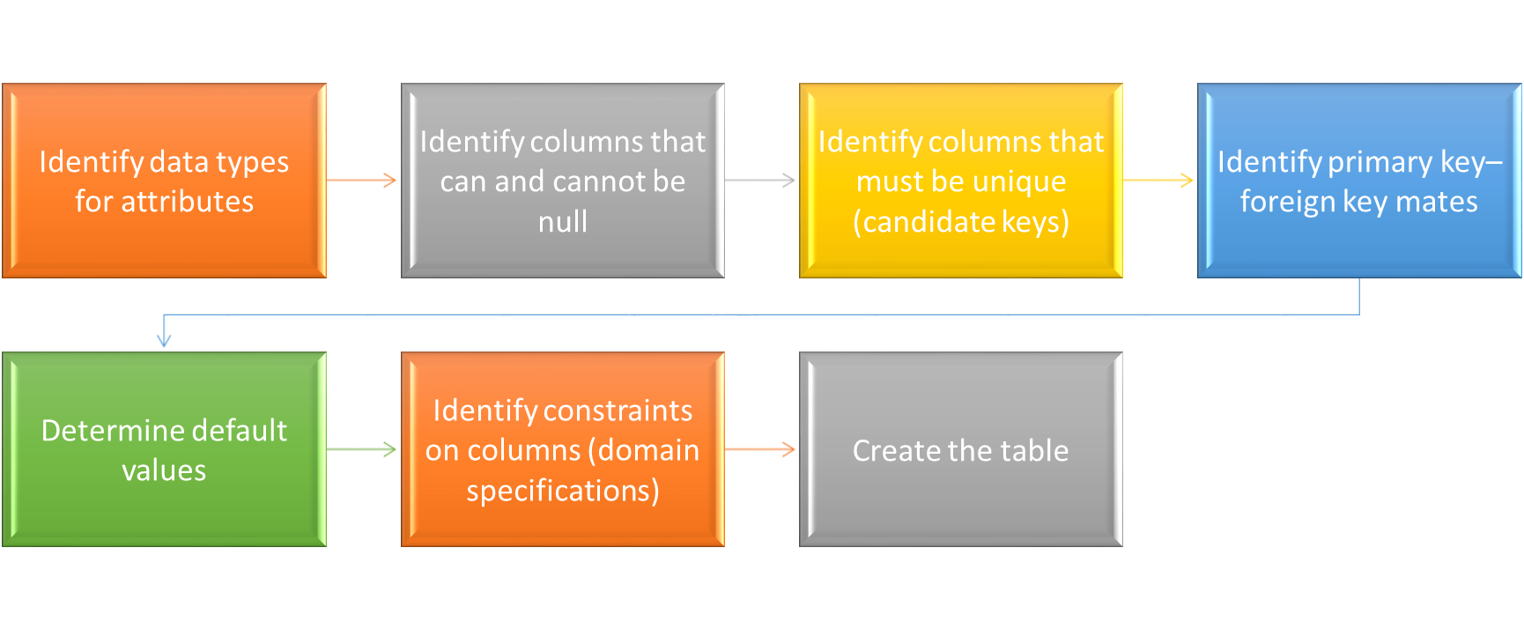
Steps for creating a table

Slide 8


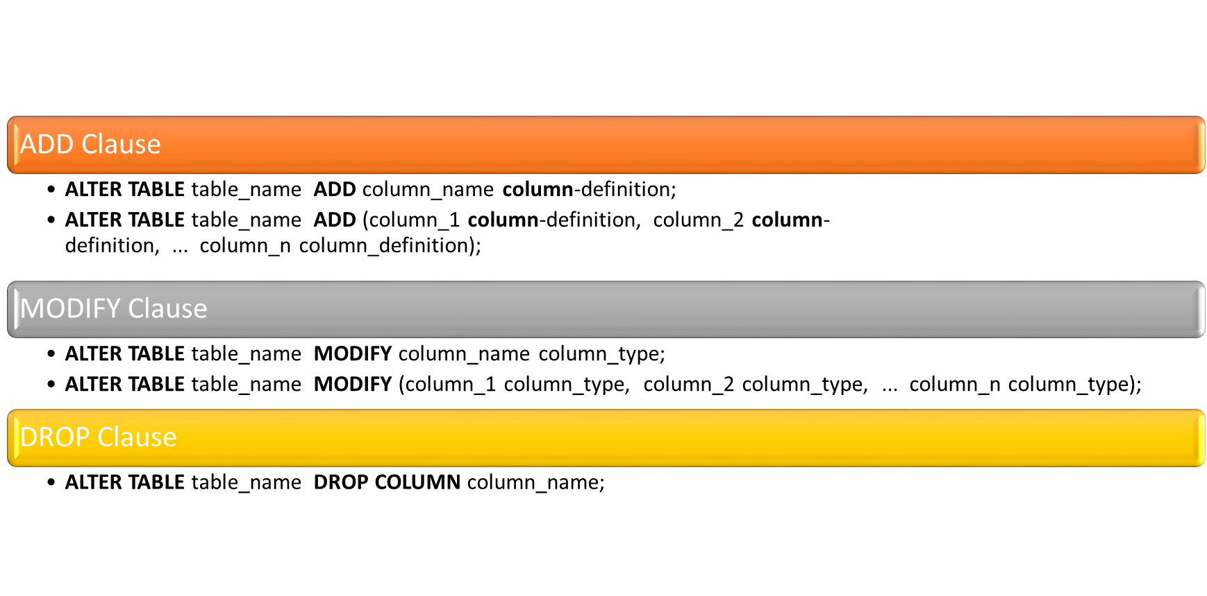
ALTER TABLE Statement

Slide 9

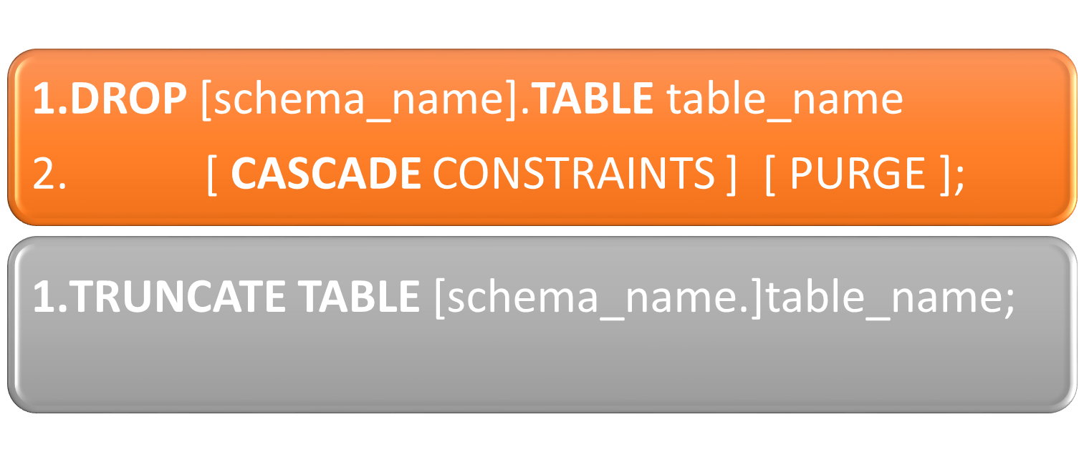
DROP & TRUNCATE TABLE Statements

Slide 10

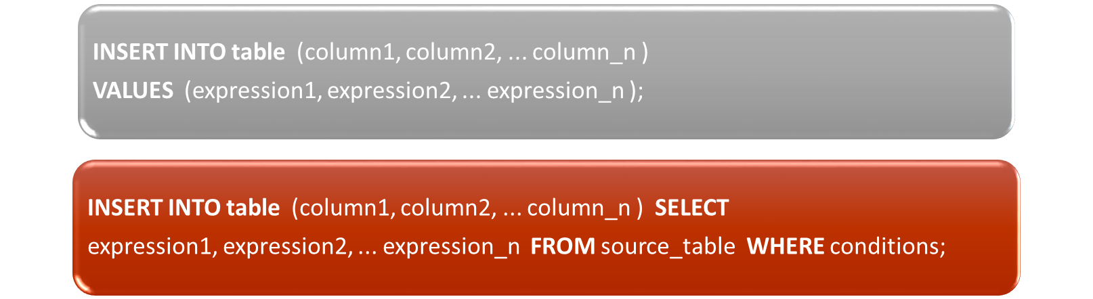
Insert Statement

Slide 11
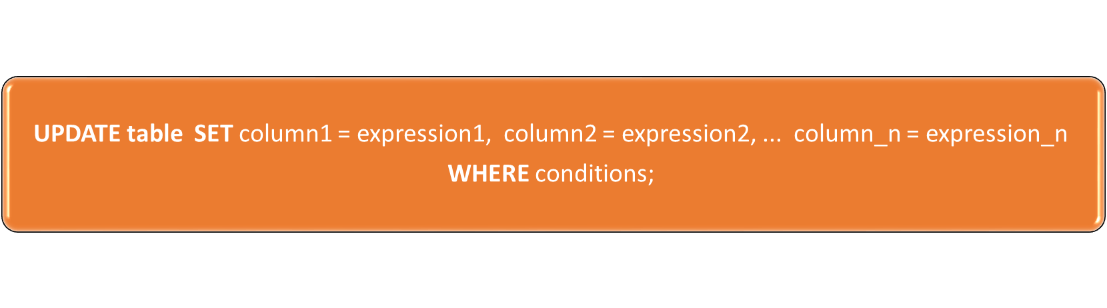
UPDATE Statement

Slide 12

DELETE Statement

Slide 13


